Slide 1

Titanic Challenge
Elie Yaacoub
Numerical Algorithms Course @ EPITA
June 2022

Slide 2
Introduction
In this challenge, I will build a predictive model that answers the question: “what sorts of people were more likely to survive?” using passenger data (ie name, age, gender, socio-economic class, etc)

Slide 3
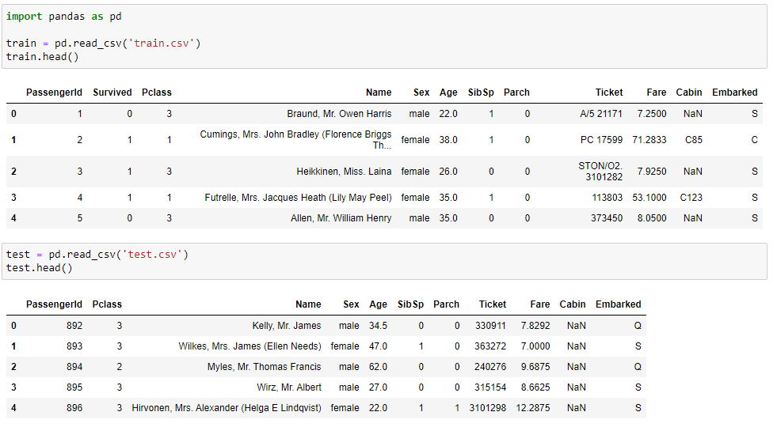
Input Data
The data has been split into two groups:
training set (train.csv)
test set (test.csv)

Slide 4

Data Analysis and Preparation

Slide 5
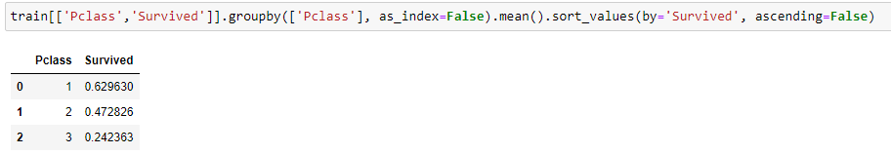
Pclass

Slide 6
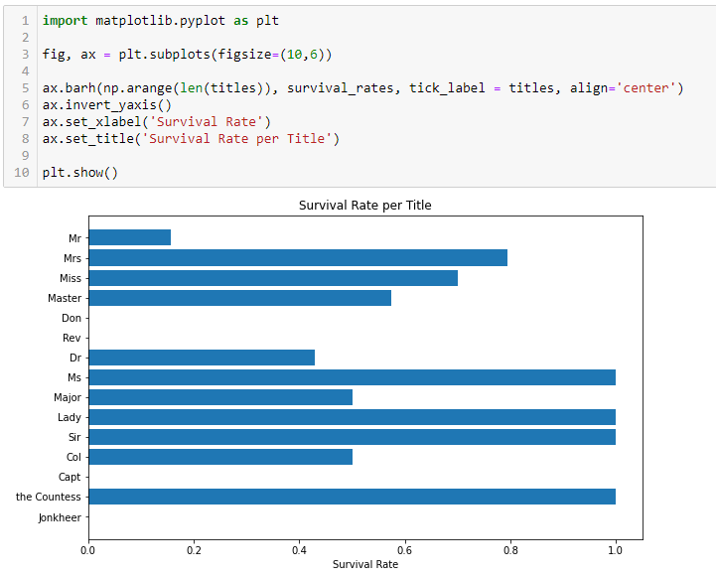
Name

Slide 7
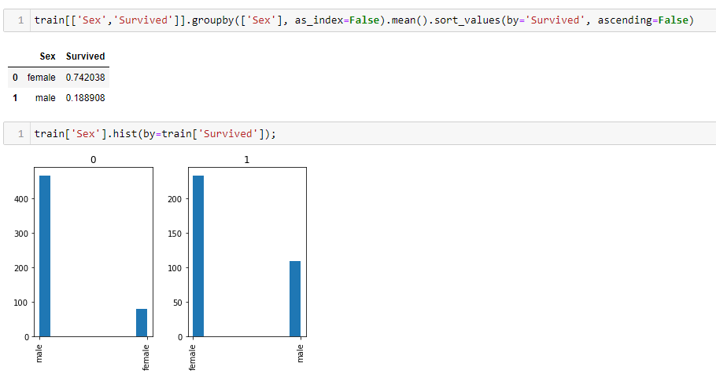
Sex

Slide 8
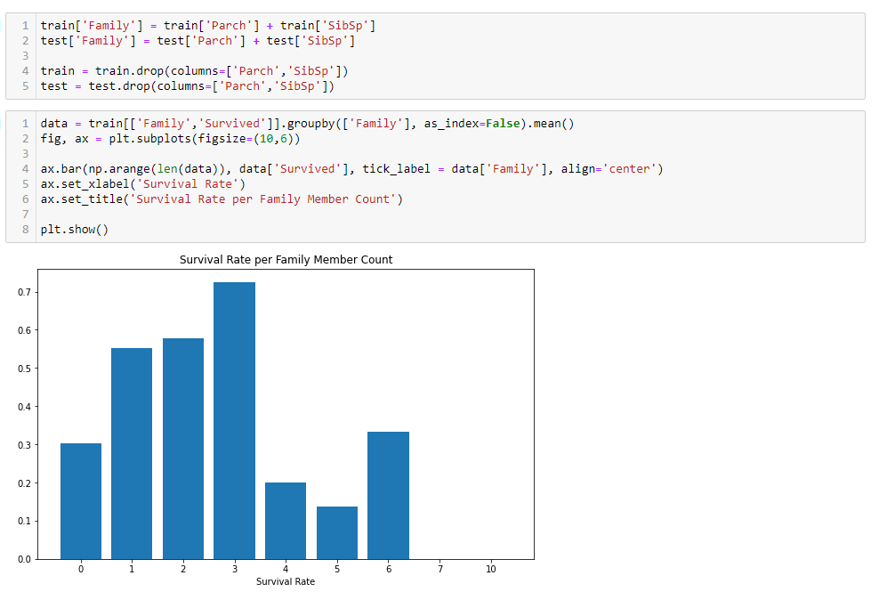
SibSp and Parch

Slide 9
Ticket
We are not interested in this column

Slide 10
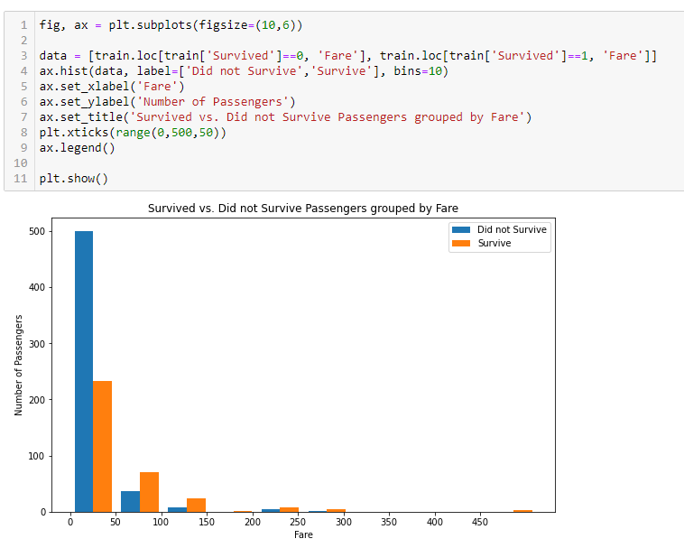
Fare

Slide 11
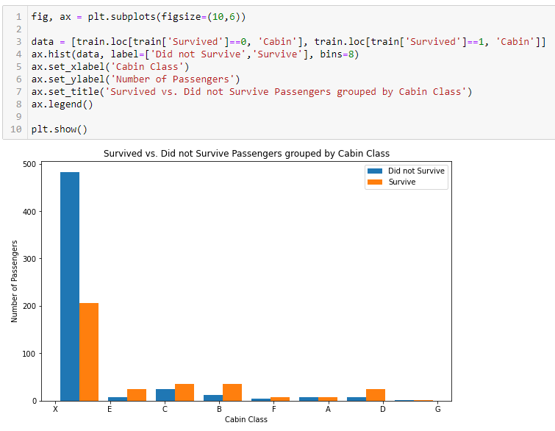
Cabin

Slide 12
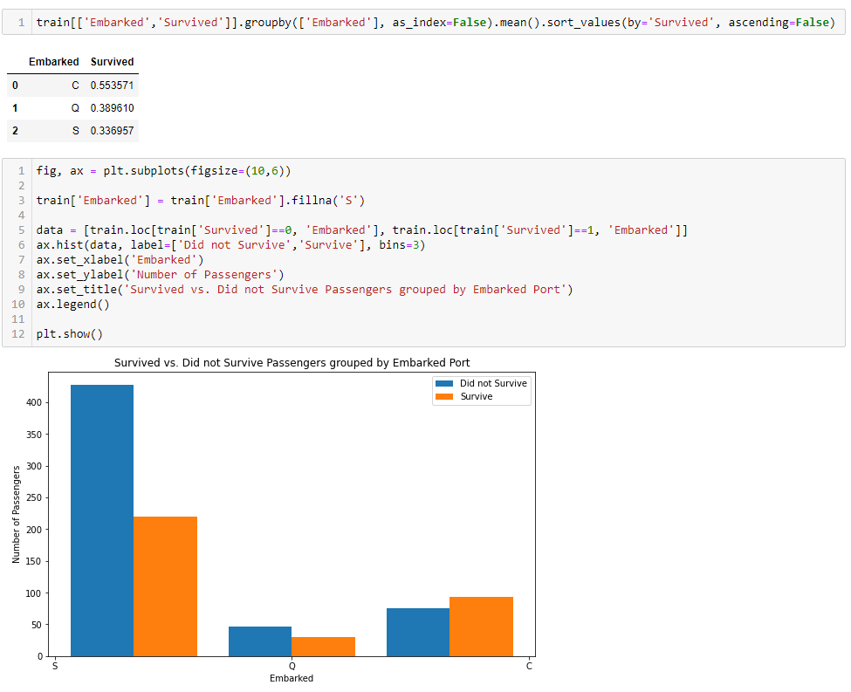
Embarked

Slide 13
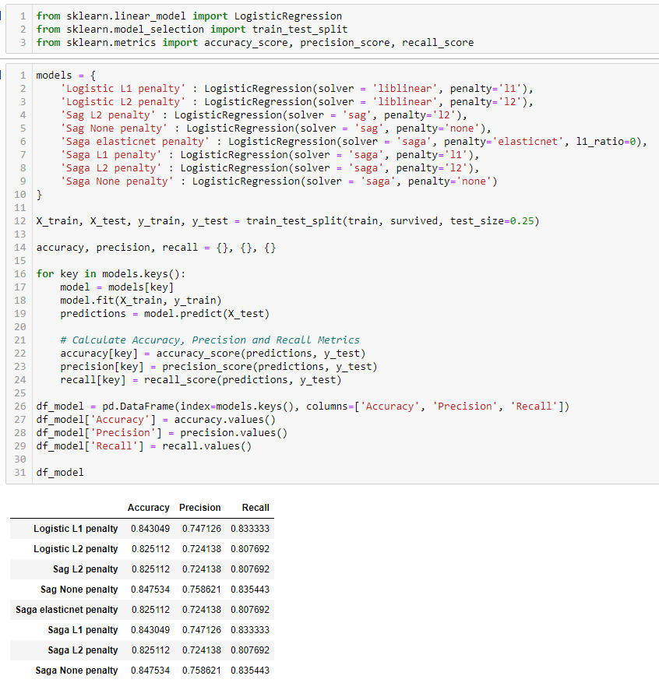
Prediction
We will use Logistic Regression model from scikit learn

Slide 14
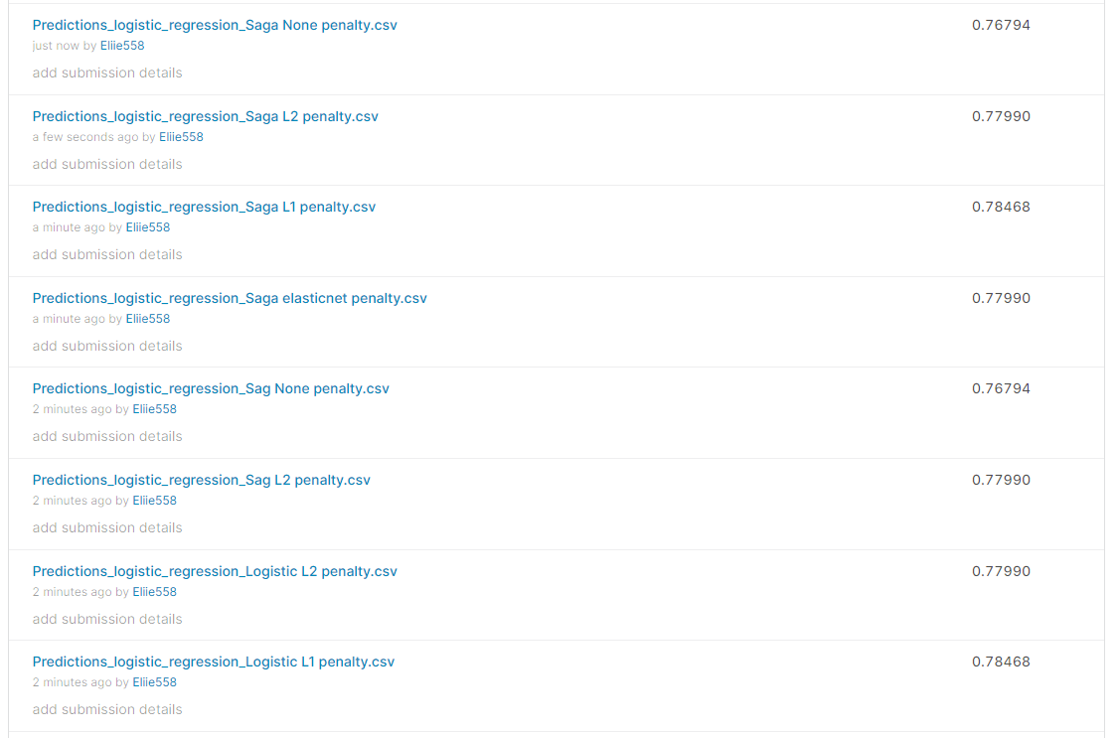
Results

Slide 15
Solvers
For small datasets, ‘liblinear’ is a good choice, whereas ‘sag’ and ‘saga’ are faster for large ones;
For multiclass problems, only ‘sag’ and ‘saga’ handle multinomial loss
‘liblinear’ is limited to one-versus-rest schemes.

Slide 16
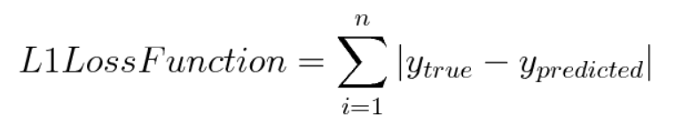
L1 loss function

Slide 17

Questions?

